Slide 1
Coping

Slide 2
Cope
(Of a person) deal effectively with something difficult

Slide 3
Coping
“Efforts to master, reduce, or tolerate the demands created by stress”
General points for consideration:
People cope with stress in many ways.
It is most adaptive to use a variety of coping strategies.
Coping strategies vary in their adaptive value.

Slide 4
Common Coping Patterns
Giving up
People may develop learned helplessness – “passive behavior produced by exposure to unavoidable aversive events”.
Sometimes, could then be transferred to situations in which the person is not really helpless.
This then creates a passive reaction to stressful events, rather than active problem-solving.

Slide 5
Giving up, continued
Cognitive interpretation of aversive events may determine whether we feel helpless or not.
People with a pessimistic explanatory style view aversive events as “out of their control”, feel helpless, and give up.
This coping strategy is called behavioral disengagement and is associated with increased distress.

Slide 6
Acting aggressively
Frustration caused by stressful events may elicit aggression, “behavior intended to hurt someone, either physically or verbally”.
People often act out toward others who had nothing to do with their frustration.
Using a substitute target in this manner was called displacement by Freud.

Slide 7
Freud believed aggressive acts could release pent-up emotional tension and called the process catharsis.
However, research finds that acting aggressively produces more, not less, anger and aggression.

Slide 8
Indulging yourself
When stressed by events that are going poorly, some people seek out alternative sources of satisfaction:
Excessive eating, drinking, and smoking;
gambling & drug use; and
Internet addiction – “spending an inordinate amount of time on the Internet and inability to control online use”

Slide 9
Blaming yourself
People often become highly critical of themselves when stressed.
Albert Ellis called this catastrophic thinking, which involves
Attributing failures to personal shortcomings;
Focusing on negative feedback; and
Being overly pessimistic about the future.
This pattern perpetuates negative emotional reactions to stress.

Slide 10
Using defensive coping
Defense mechanisms are “largely unconscious reactions that protect a person from unpleasant emotions such as anxiety and guilt”.
Defense mechanisms shield us from emotional discomfort caused by stress.
However, most involve a degree of self-deception, a distortion of reality.

Slide 11
Defense mechanisms are considered normal, and can operate at various levels of consciousness.
Can they ever be healthy?
Generally, they are not, because
They are avoidance strategies;
They often involve “wishful thinking”; and
Some have been linked to poor health.

Slide 12
Are they healthy?, continued
Sometimes, however, they are useful for severe stress because they buffer us from extremely negative emotions.
(e.g., unrealistic optimism may benefit a terminally ill patient.)

Slide 13
Constructive coping - “refers to efforts to deal with stressful events that are judged to be relatively healthful”.
Constructive coping involves:
Confronting problems directly.
Effort.
Realistic appraisals of stress and coping resources.
Learning to recognize and manage disruptive emotional reactions to stress.
Learning to exert some control over potentially harmful or destructive habitual behaviors.

Slide 14
There are three main categories of constructive coping strategies:
Appraisal-focused
Problem-focused
Emotion-focused

Slide 15
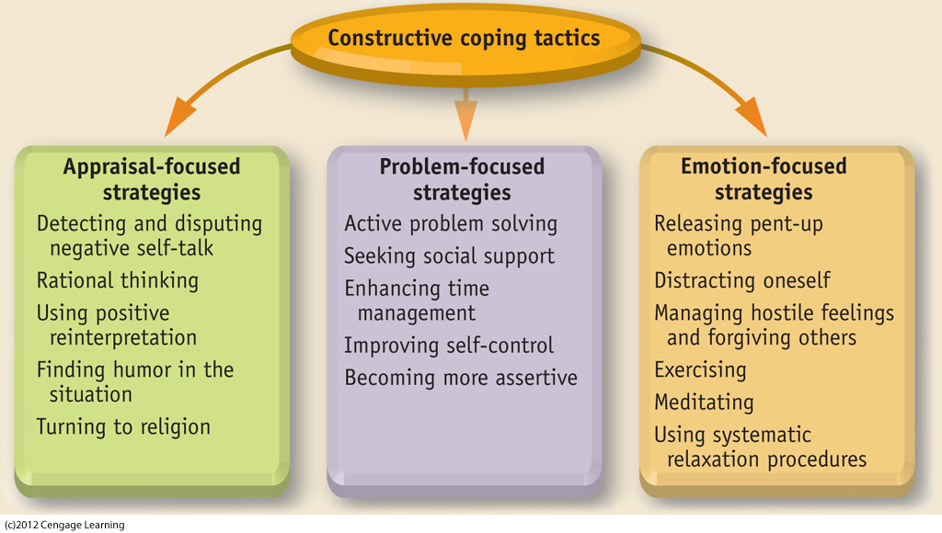
Figure 4.6. Overview of constructive coping tactics. Coping tactics can be organized in several ways, but we will use the classification scheme shown here, which consists of three categories: appraisal-focused, problem-focused, and emotion-focused strategies. The list of coping tactics in each category is not exhaustive. We will discuss most, but not all, of the listed strategies in our coverage of constructive coping.
Notes:
INSERT FIG 4.6

Slide 16
Appraisal-Focused Coping
Our appraisal (or beliefs about stressful events) is critical to the coping process.
Negative appraisals (or beliefs) are often associated with catastrophic thinking, which exaggerates the magnitude of our problems.
Positive (realistic and/or optimistic) appraisals allow constructive coping.

Slide 17
Positive reinterpretation can also buffer stress in the following ways:
We can recognize that “things could be worse”.
We can utilize “benefit finding” in a bad situation (searching for something good in a bad experience).

Slide 18
Problem-Focused Coping
Using systematic problem-solving
Evidence shows that problem-solving skills can be increased through training (Heppner & Lee, 2002, 2005) and by using these steps:
Clarify the problem.
Generate alternative courses of action.
Evaluation alternatives and select a course of action.
Take action while maintaining flexibility.

Slide 19
Seeking help
It is often helpful to seek aid from friends, family, coworkers, and neighbors.
Cultural factors in seeking help:
Asians, Asian Americans, and individuals from collectivistic cultures are less likely to seek help from others.
This is based in a cultural tendency to avoid “burdening” others with one’s problems.

Slide 20
Using time more effectively: Time Management
A common source of stress is feeling there is not enough time to accomplish tasks.
Often, this can be improved by using the time we have more effectively.

Slide 21
Using time more effectively, continued
The causes of wasted time
Inability to set or stick to priorities.
Inability to say “no” to others’ demands on our time.
Inability to delegate responsibility.
Inability to throw things away.
Inability to accept anything less than perfection.

Slide 22
Emotion Focused Coping
Emotional intelligence – “the ability to perceive and express emotion, use emotions to facilitate thought, understand and reason with emotion, and regulate emotion”.

Slide 23
Emotion-Focused Coping, continued
Emotional intelligence has four components:
Accurately perceiving emotions in yourself and others.
Knowing how your emotions shape your thinking.
An understanding of complex or contradictory emotions.
Regulation of emotions, especially negative ones.

Slide 24
Emotion-Focused Coping, continued
Expressing emotions
Efforts to actively suppress emotions, especially anger, tend to increase stress and physiological arousal.
In contrast, “emotional disclosure” is associated with better mood, more positive self-perceptions, and better health.

Slide 25
Emotion-Focused Coping, continued
Managing hostility and forgiving others
When we feel “wronged”, our natural tendency is to seek revenge or hold a grudge.
Forgiving others goes counter to these instincts, but is associated with better adjustment and well-being.

